Slide 1

Capstone Project-4
Book Recommendation sytem by Ashveen Kumar Verma (Self)

Slide 2

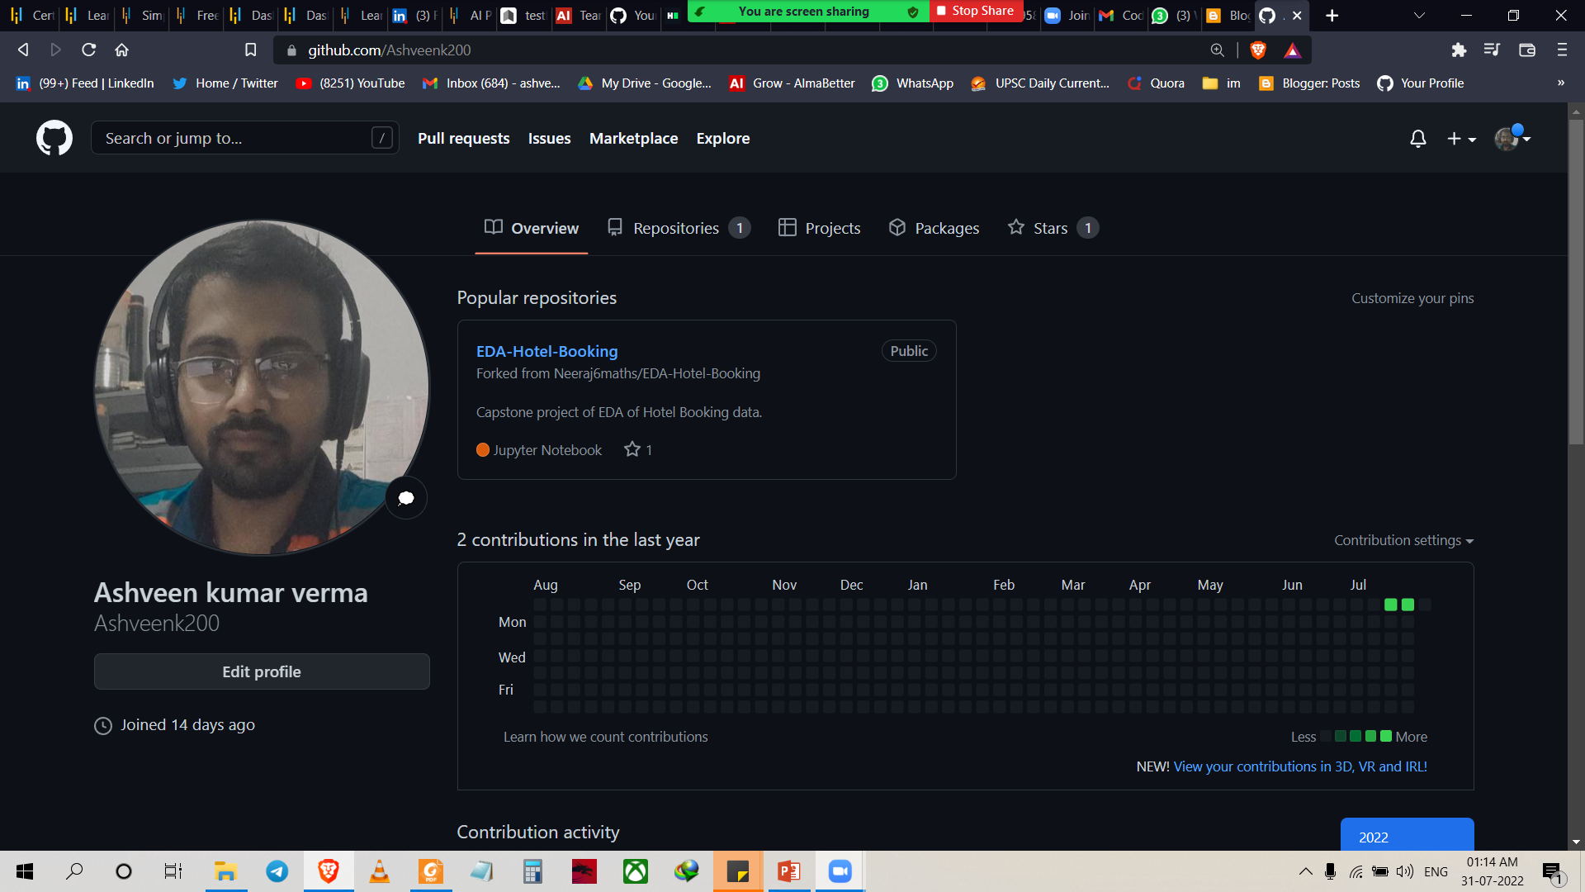
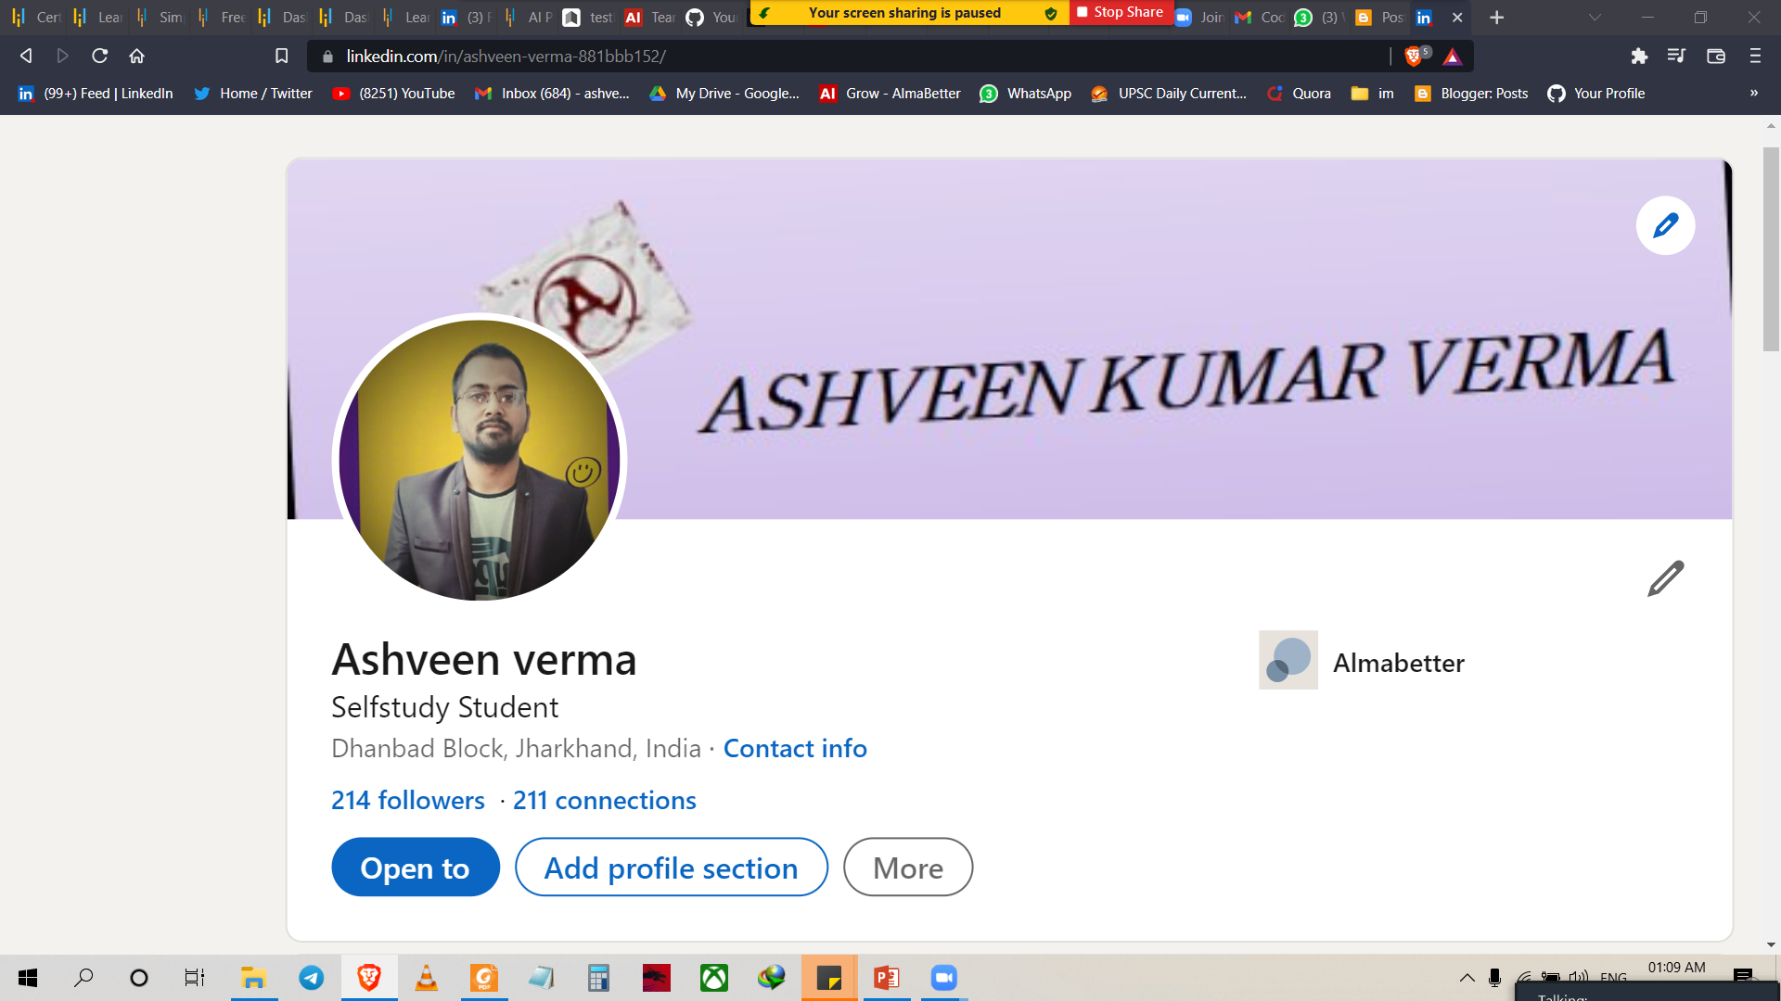
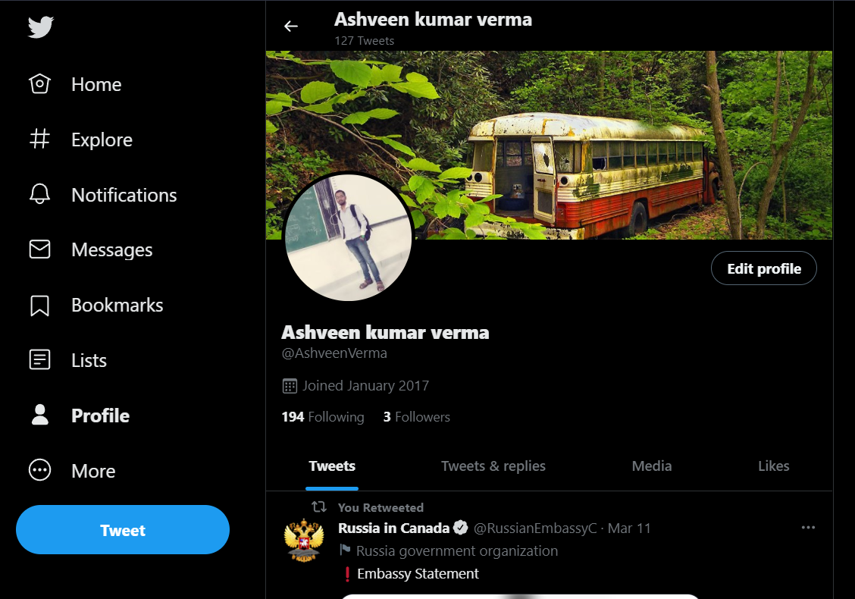

ASHVEEN KUMAR VERMA
Live in Dhanbad Jharkhand
Bsc graduate from pk roy memorial collage Dhanbad in 2020.
Enrolled in DS program.
This is my 4th capstone project
Linkedin- Ashveen verma
Github- Ashveen kumar verma
Twitter- Ashveen kumar verma

Slide 3
BOOK RECOMMENDATION SYSTEM

Slide 4

Problem Statement
During the last few decades, with the rise of Youtube, Amazon, Netflix, and many other such web services, recommender systems have become much more important in our lives in terms of providing highly personalized and relevant content.
The main objective is to create a recommendation system to recommend relevant books to users based on popularity and user interests.

Slide 5
Data Summary
The dataset is comprised of three csv files:: User_df, Books_df, Ratings_df
Users_dataset.
User-ID (unique for each user)
Location (contains city, state and country separated by commas)
Age Shape of Dataset - (278858, 3)
Books_dataset.
ISBN (unique for each book)
Book-Title
Book-Author
Year-Of-Publication
Publisher
Image-URL-S
Image-URL-M
Image-URL-L
Shape of Dataset - (271360, 8)
Ratings_dataset.
User-ID
ISBN
Book-Rating
Shape of Dataset - (1149780, 3)

Slide 6
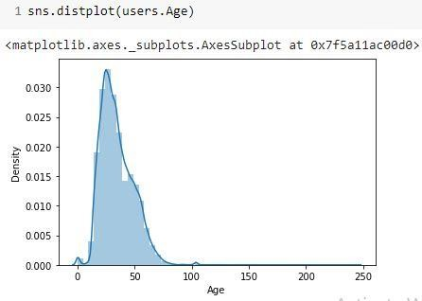
Observations from Users_df (Age)
The Age range given here is from 0 To 250.
Outliers in the Age column.

Slide 7
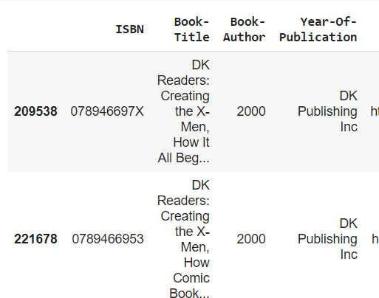
Replacing strings by int values

Slide 8
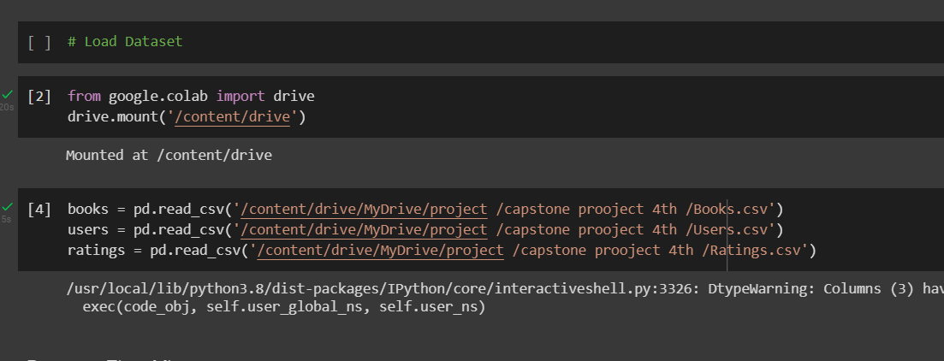
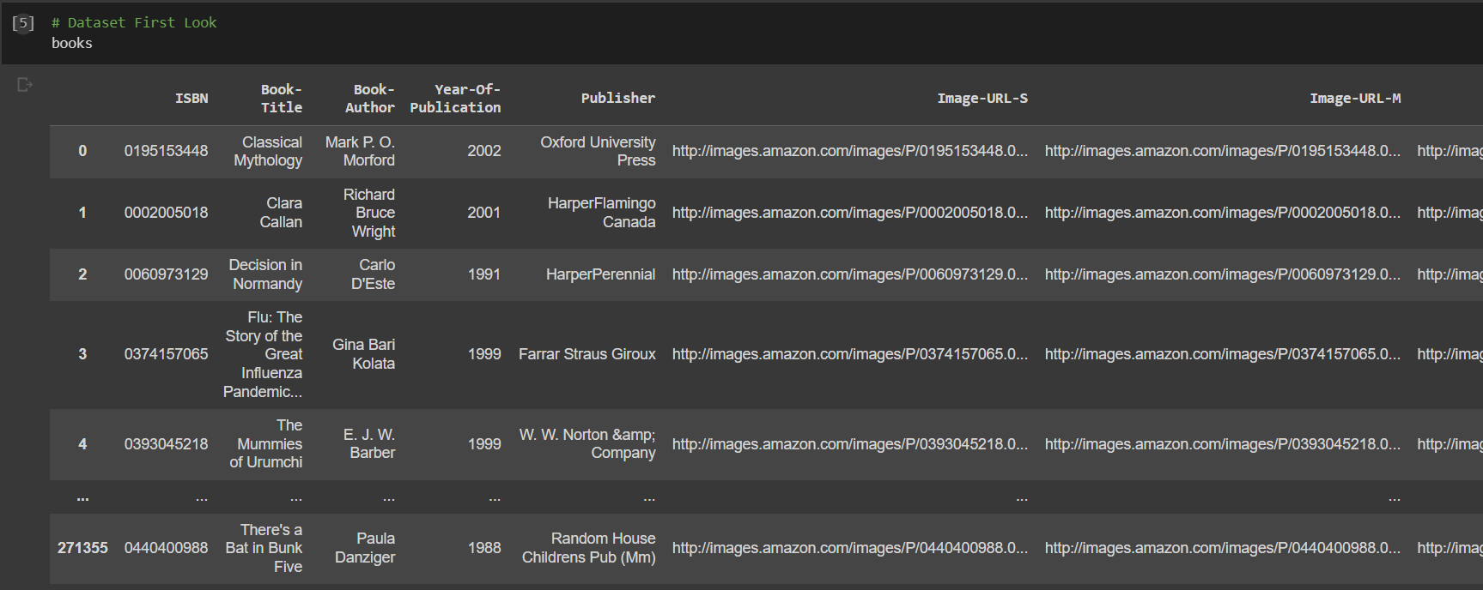
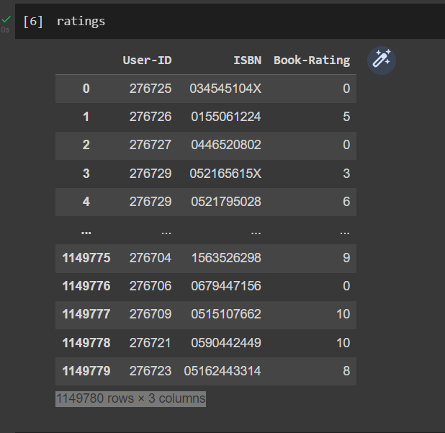
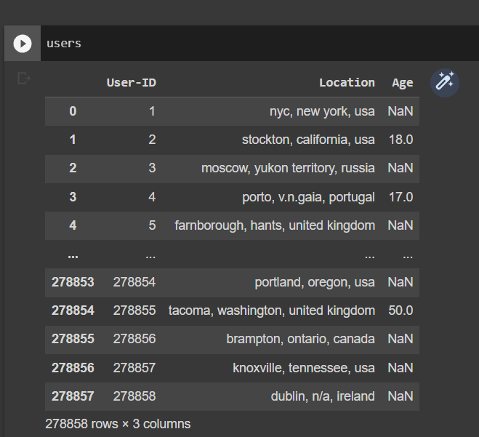
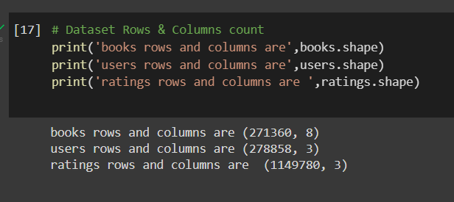
Data cleaning and Manupulation :-

Slide 9
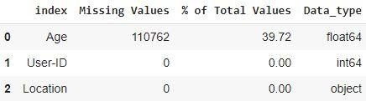
Data Cleaning
1. Null Value Imputation:
Age column has 40% missing values

Slide 10
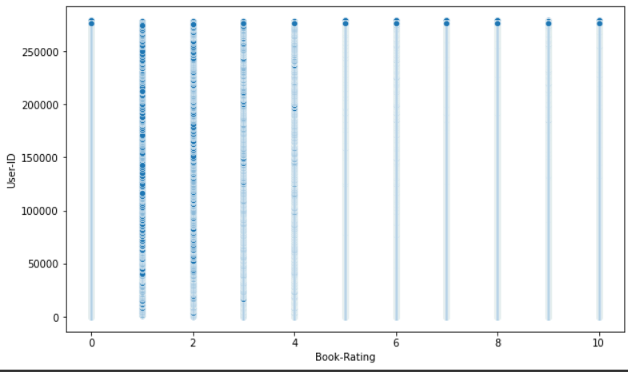
Exploratory Data Analysis(EDA)

Slide 11
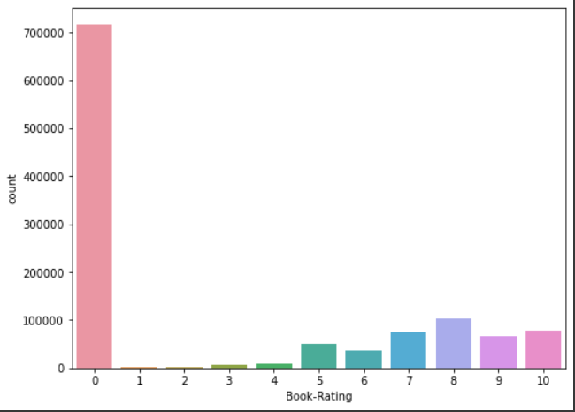
Exploratory Data Analysis(EDA)
Conclusion:-
The graph shows maximum no. of users are not giving rating to the book they just read it only
Very less no. of user has given 1 star to book

Slide 12
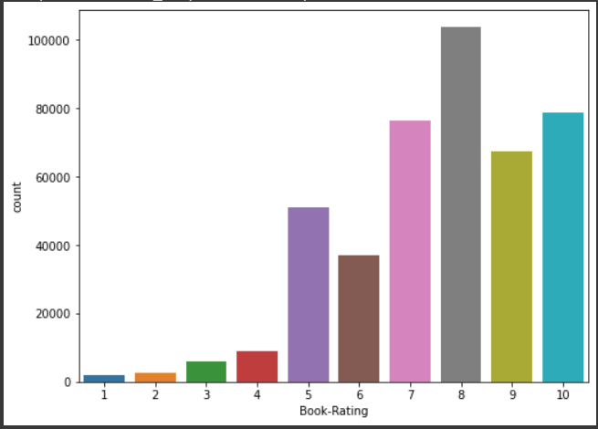
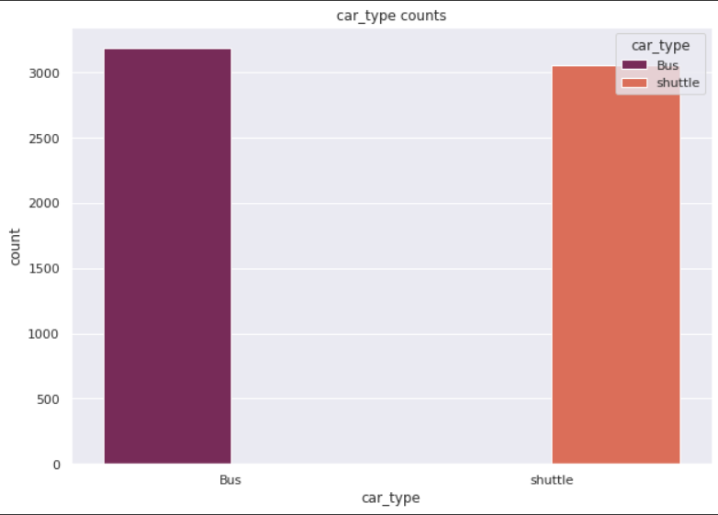
Exploratory Data Analysis(EDA)
Conclusion
From graph we can conclude that book whose rating is 8 has highiest no. of users
Book has rating 1 has lowest no. of users

Slide 13
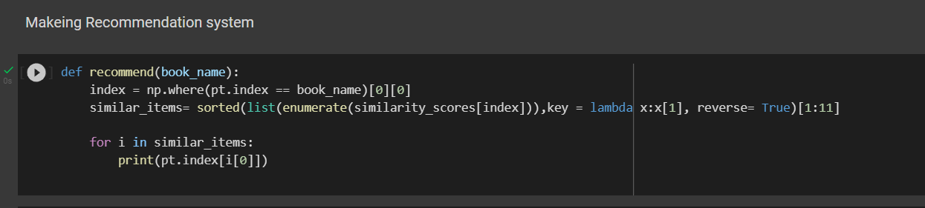
Making Recommendation System

Slide 14
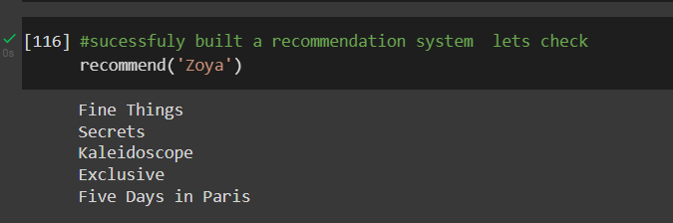
Recommendtion system testing
Conclusion
From the picture it is clear we successfully made book recommendation system and its recommending 5 output book with k-nearest point.

Slide 15
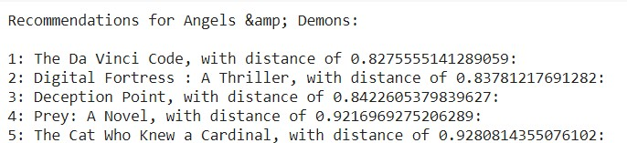
Collaborative Filtering-(Item-Item based)
3.)Collaborative Filtering-(Item-Item based)
Cosine Similarity
Nearest Neighbour

Slide 16

Different Models
Test set: actual top rated books

Slide 17
Conclusion
A recommendation system helps an organization to create loyal customers. The recommendation system today are very powerful that they can handle the new customer too who has visited the site for the first time. They recommend the products which are currently trending or highly rated and they can also recommend the products which bring maximum profitto the company.
A book recommendation system is a type of recommendation system where we have to recommend similar type of books to the reader based on his interest. The books recommendation system is used by online websites which provide ebooks like google playbooks, open library, good Read’s, etc.

Slide 18
Future Scope
Given more information regarding the books dataset, namely features like Genre, Description etc, we could implement a content-filtering based recommendation system and compare the results with the existing collaborative-filtering based system.
We would like to explore various clustering approaches for clustering the users based on Age, Location etc., and then implement voting algorithms to recommend items to the user depending on the cluster into which it belongs.

Slide 19


